Slide 1

Overview

Slide 2
What is Governance?
The rules by which a society operates...
...including how those rules are changed.

Slide 3
Polkadot was built to evolve

Slide 4
What can you do using Governance?
Change system parameters (number of validators, block time, slashing penalty...)
Alter / revert system behaviors (revert slashing events…)
Change the runtime itself (including the governance mechanism)

Slide 5
Who can make changes?
Any token holder can propose changes
Any token holder can vote on those changes
How? With tokens!

Slide 6
Coin voting
1 person - 1 vote isn’t feasible in practice
More tokens means more power
But there’s more…

Slide 7

Example

Slide 8
Example
Proposal #1
Set the block time to 10min.

Slide 9
Proposal #1
Set the block time to 10min.
Proposal #2

Slide 10



Proposal #1
Set the block time to 10min.
Proposal #2

Slide 11
Proposal #1
Set the block time to 10min.
Proposal #2

Slide 12
Seconding a proposal
Proposal #1
Set the block time to 10min.
Proposal #2

Slide 13
Proposal #1
Set the block time to 10min.
Referendum #3
Set the block time to 10min.
Proposal #2

Slide 14
Referendum #3
Set the block time to 10min.
Yes
No

Slide 15
Referendum #3
Set the block time to 10min.
Yes
No

Slide 16
Vote locking
Referendum #3
Set the block time to 10min.
Yes
No
1x
4x
1x

Slide 17

Vote locking
Referendum #3
Set the block time to 10min.
Failed

Slide 18
Turnout bias
Passing threshold (%)
Approved
50%
Failed
0%
Turnout (%)
0%

Slide 19
Turnout bias
Passing threshold (%)
Approved
50%
Failed
0%
20%
Turnout (%)
0%

Slide 20
Turnout bias - super majority approval
Approved
Passing threshold (%)
Failed
0%
Turnout (%)
0%

Slide 21
Turnout bias - super majority approval
Approved
80%
Passing threshold (%)
Failed
0%
25%
Turnout (%)
0%

Slide 22
Turnout bias - super majority approval
Approved
Passing threshold (%)
50.*%
Failed
0%
99%
Turnout (%)
0%

Slide 23
Threshold: super majority approval Total supply: 16 DOTs
Referendum #3
Set the block time to 10min.
Yes
No
1x
1x
1x

Slide 24
Threshold: super majority approval Total supply: 16 DOTs
Referendum #3
Set the block time to 10min.
Yes
No
1x
1x
1x
= 3
= 1
Yes: 75% No: 25%
Turnout : 25% (4/16 DOTs)

Slide 25
Turnout bias - super majority approval
Approved
80%
Passing threshold (%)
Failed
0%
25%
Turnout (%)
0%

Slide 26
Recap
Anyone can propose and anyone can vote with coins
Votes can be weighted (multiplied) if locked longer
A proposal submitted by anyone (like ) has a bias and can be rejected with a few “no”s at low turnout

Slide 27
Council
Set of accounts that are voted in
12-24 accounts
Anyone can be part of the council
Being elected on a rolling basis (~1 weeks)

Slide 28
Turnout bias - super majority rejection
Passing threshold (%)
Approved
Failed
0%
Turnout (%)
0%

Slide 29
The platform to discuss and vote
for Kusama and Polkadot Governance

Slide 30
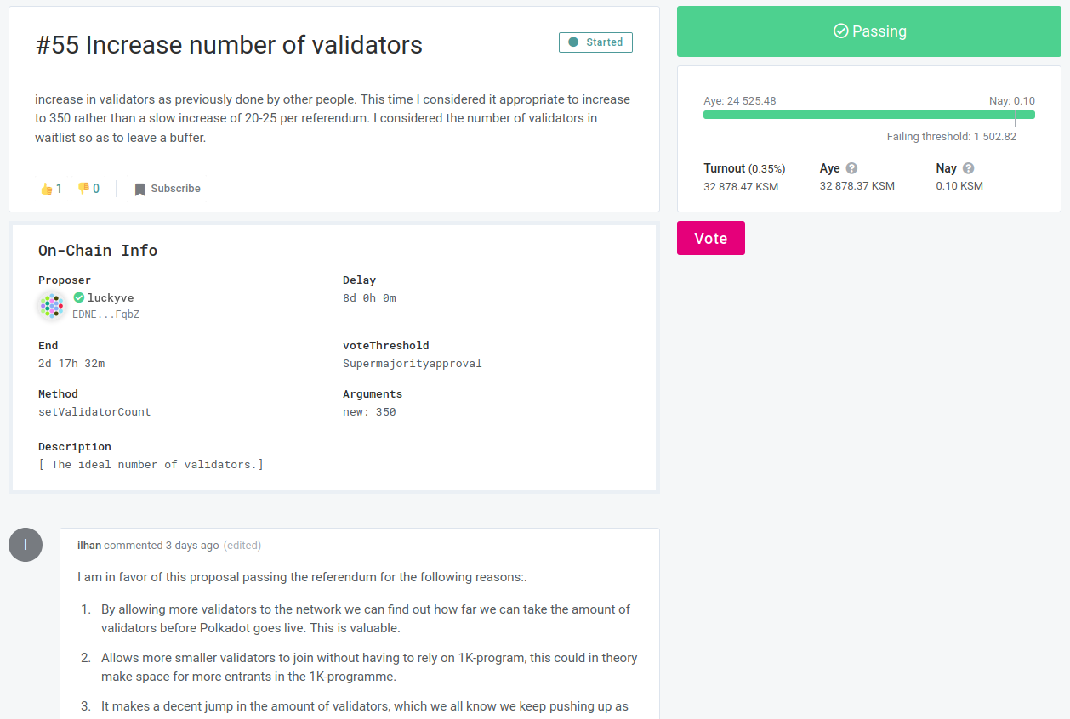

Slide 31
